Slide 1
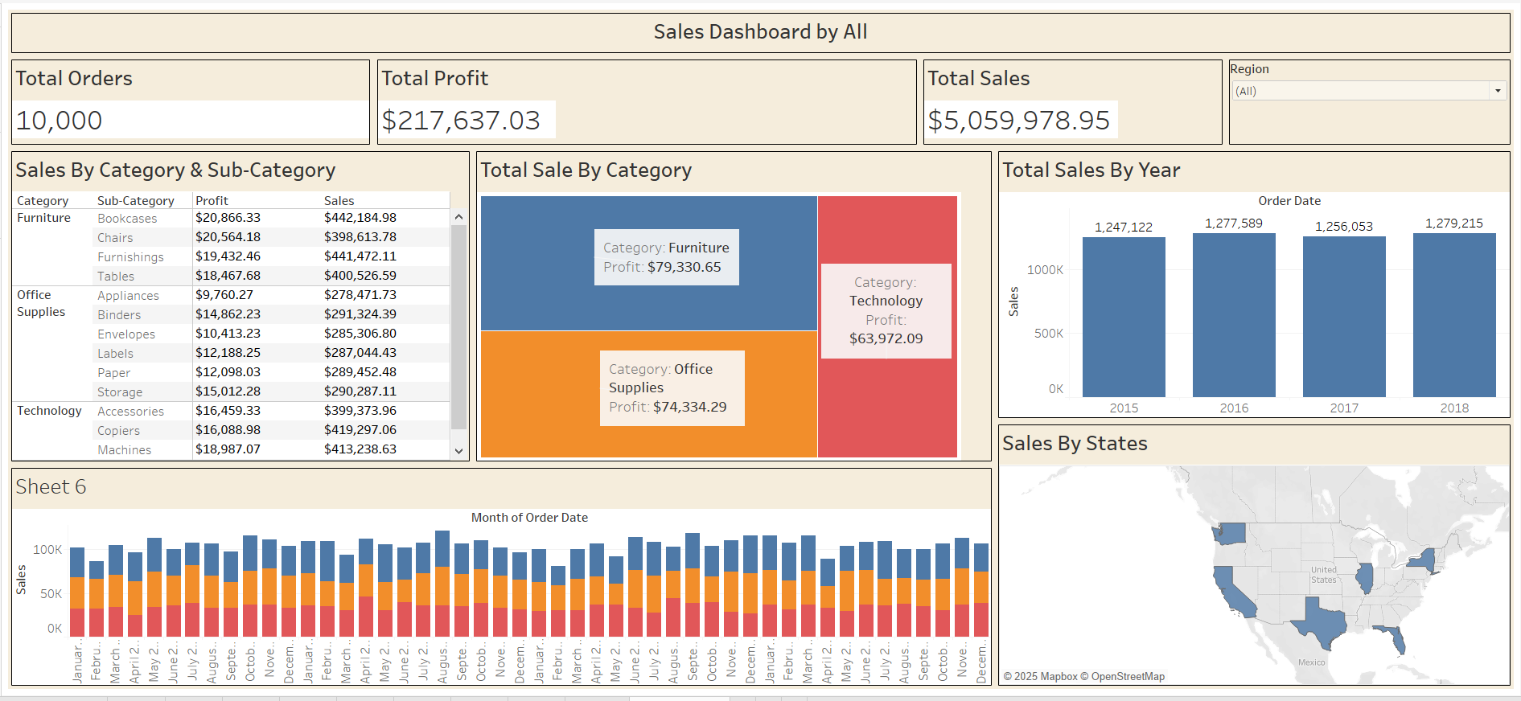
Project Sales Dashboard

Slide 2
Overview
The retail industry thrives on data-driven insights to optimize performance, understand customer behavior, and increase profitability.
In this project, I have created an interactive sales dashboard using Tableau to analyze a superstore dataset.
The dashboard provides valuable insights into total sales, profits, and order volume, along with performance breakdowns by category, sub-category, region, and state. This visualization helps identify trends, high-performing products, and potential areas for improvement. By leveraging Tableau’s powerful data visualization capabilities, the dashboard enables stakeholders to make informed decisions and drive strategic growth.

Slide 3
Dataset Details
The dataset includes the following fields:
Order ID - Unique identifier for each order
Order Date - Date when the order was placed
Ship Date - Date when the order was shipped
Customer Name - Name of the customer
Segment - Type of customer (Consumer, Corporate, Home Office)
State / Region - Geographic location
Category / Sub-Category - Product classification
Sales - Revenue from the order
Profit - Net earnings from the order
Quantity / Discount - Units sold and discounts offered

Slide 4
KPI Tiles
Charts: Big Numbers (Single Value Cards)
Fields Used:
Total Sales → SUM(Sales)
Total Profit → SUM(Profit)
Total Orders → COUNTD(Order ID)
Purpose: Display high-level business metrics at a glance. These KPIs give an instant overview of performance and are usually positioned at the top of the dashboard.

Slide 5
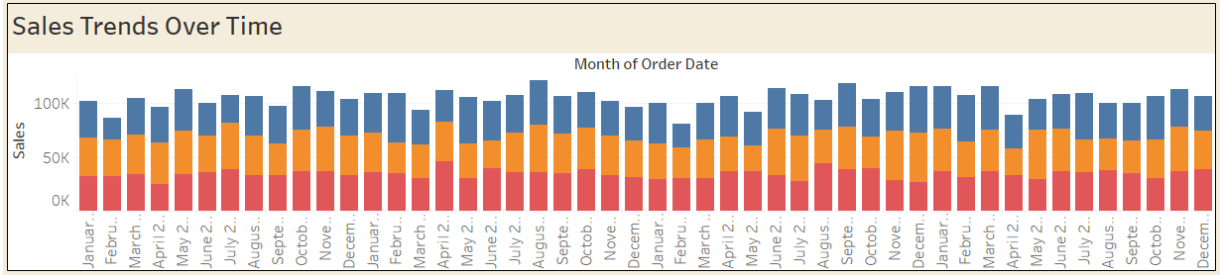
Sales Trend Over Time
Chart Type: Line Chart
Fields Used:
Columns: Order Date (by Month or Year)
Rows: SUM(Sales)
Optional: Add Segment or Region to Color for comparison
Purpose: Shows how sales evolve over time. Helps identify seasonality, trends, and growth patterns.

Slide 6
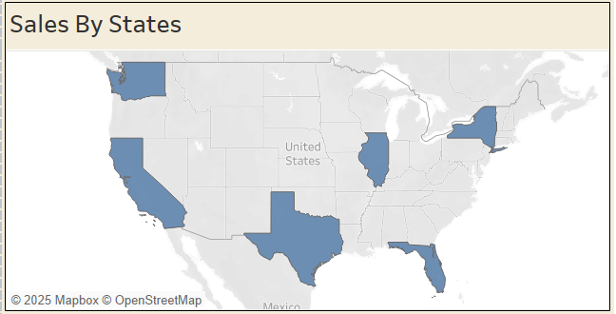
Sales By State Or Region
Chart Type: Filled Map
Fields Used:
Location: State or Region
Color: SUM(Sales)
Optional Tooltip: Profit, Orders, Profit Margin
Purpose: Geographic view of sales performance. Highlights which areas generate the most revenue and where attention is needed.

Slide 7
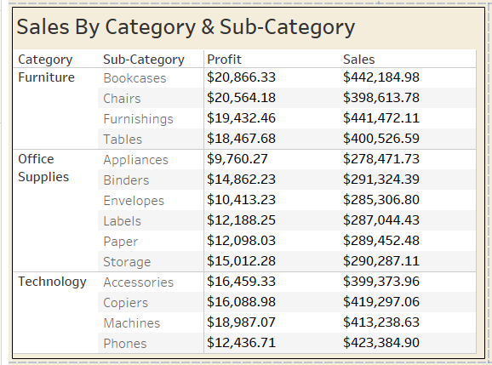
Sales By Category & Sub-Category
Chart Type: Horizontal or Vertical Bar Chart
Fields Used:
Rows: Category or Sub-Category
Columns: SUM(Sales) or SUM(Profit)
Color: Optional by Profit for quick visual cues
Purpose: Breaks down sales and profit across product categories. Useful for product managers and inventory planners.

Slide 8
Insights Extracted
Highest sales were recorded in the Technology category.
California had the highest overall sales across all regions.
consistently showed strong sales performance.
Top-performing customer segments included Corporate and Consumer.
Certain products showed negative profit, indicating need for pricing or discount strategy review.

Slide 9
Conclusion
The Sales Dashboard demonstrates transforming raw data into meaningful business insights. By leveraging interactive visuals and intuitive filters, this report enables users to explore sales trends, identify top-performing products, and gain a clearer understanding of overall business performance..

Slide 10
